Slide 1

Linux Virtualization Based Security (LVBS)
Linux Plumbers Conference 2023
Thara Gopinath, Mickaël Salaün, James Morris

Slide 2
Agenda
Architecture Overview
Hyper-V Implementation
KVM Implementation (Heki)
Q&A
Notes:
Total time: 45 mins.
Sections:
- Overview: 8 mins
- Hyper-V: 16 mins
- HEKI: 16 mins
- Q&A: 5 mins

Slide 3
Architecture Overview
James Morris

Slide 4
Linux Virtualization Based Security
(LVBS)
Use virtualization to provide enhanced security for the guest OS, leveraging the hypervisor security boundary.
Notes:
- Mickael discussed KVM details yesterday, we will take a step back here to provide a broader overview.
- Define VBS
- provides a security monitor outside of the kernel; in principle is more difficult to attack from kernel itself
- utilize security boundary
- Explain LVBS as extensible VBS architecture for Linux
- Overall model: [hv] [TEE] [TAs] [VMM] [Guest kernel & userland]
Acknowledge existing work
Harden guest kernel and guest userland
Provide support for a security monitor / TEE
Can run services such as code integrity, key management

Slide 5
Linux Virtualization Based Security
(LVBS)
Protect the integrity of security-critical guest structures.
Notes:
- Structures include: page permissions, CPU registers, data structures, executable memory (authenticated only).
- Define VBS
- utilize security boundary
- Explain LVBS as extensible VBS architecture for Linux
- Overall model: [hv] [TEE] [TAs] [VMM] [Guest kernel & userland]
Acknowledge existing work
Harden guest kernel and guest userland
Provide support for a security monitor / TEE
Can run services such as code integrity, key management

Slide 6
Linux Virtualization Based Security
(LVBS)
Prevent bypass of guest security mechanisms and policies.
Notes:
-e.g. SELinux enforcing; policy database load; AVC is unsolved

Slide 7
Linux Virtualization Based Security
(LVBS)
Support a Trusted Execution Environment (TEE) for running security applications
  Executable code integrity
  Key management
  Others
Notes:
CI includes kernel modules, eBPF etc. as well as all userland binaries, scripts with some limitations
Key management: prevent exfiltration

Slide 8
Rationale
Bring mainline Linux to state of the art.
Linux is trailing proprietary solutions across Linux and other OSs.
Attacks continue to evolve, along with motivation levels.
Notes:
State of the art in terms of both available/comparable technologies, and of attacks.
Note: does not replace KSPP, is another layer.

Slide 9
LVBS
Architecture
Open-source architecture for Linux.
Independent of:
  ISA
  Hypervisor
  VMM
  Security monitor
  TEE implementation
Notes:
Need simple diagram here.

Slide 10
Approach
Mainline acceptance across ecosystem is critical to success
Reference implementation (HEKI):
  KVM
  Linux kernel API
  Flexible kernel hardening policy
We are seeking feedback and collaboration.
Notes:
We are working on Hyper-V VSM scheme for Linux, welcome other hypervisors & approaches.

Slide 11
Hyper-V Implementation
Thara Gopinath

Slide 12
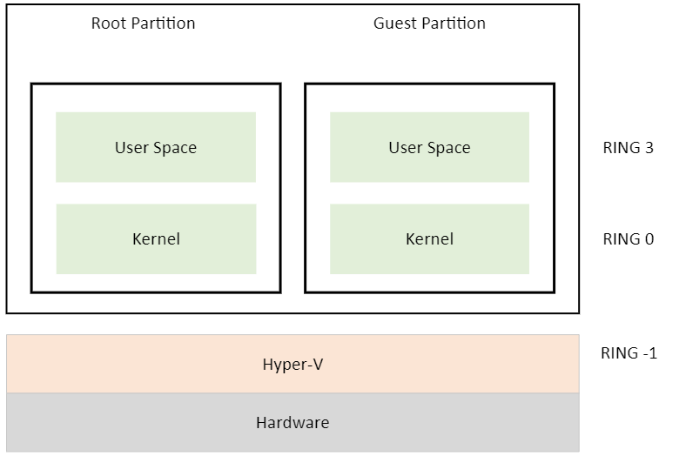
Hyper-V based System

Slide 13
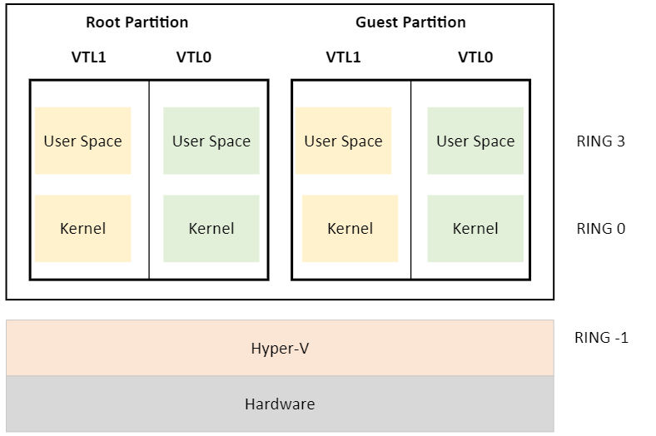
Virtual Secure Mode (VSM)​
Separate privileged execution environment within a partition : Virtual Trust Level (VTL)

Slide 14
VSM Features
Virtual Processor state isolation
Memory access hierarchy and protection
Virtual Interrupt and Intercept handling
https://learn.microsoft.com/en-us/virtualization/hyper-v-on-windows/tlfs/vsm

Slide 15
LVBS and VSM
Kernel Hardening
  Hardening memory permissions (HVCI)
  Monitoring critical system registers and MSRs
  Monitoring critical kernel data structures
Offloading policies (control flow integrity, authentication)
Offloading secure services (trustlets)
Initial Target : Basic Kernel Hardening.

Slide 16
Threat Model:
Kernel Hardening
Protect kernel from a user space attacker exploiting a kernel vulnerability
  Assume that the attacker has arbitrary read write access to guest kernel thanks to exploited vulnerability by malicious
    User space process
    Network Packet
    Block Device
  Secure Boot is trusted.
  Defence in Depth ; but no extra features!!!

Slide 17
H/W Requirements:
Second Level Address Translation (SLAT, Two-Dimensional Paging, AMD's RVI/NPT)
  Enable to manage VM memory and add a secondary complementary layer of permissions only controlled by the hypervisor)
CPU features that allow to differentiate between kernel space and user space memory (MBEC)

Slide 18
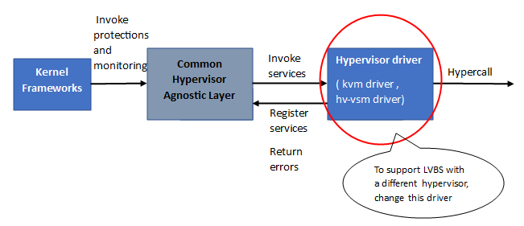
Architecture:
( Common Layer )
e.g. Hypervisor Enforced Kernel Integrity (Heki)

Slide 19
Architecture:​
​
Secure Kernel
Small TCB
Maintainability
Ability to support secure interfaces
Initial choice for secure kernel : Minimal Linux Kernel

Slide 20
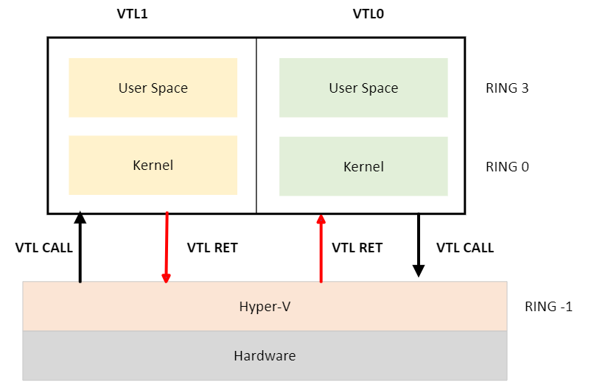
Architecture:
Control Interfaces
Synchronous : Explicit VTL Call and Return
Asynchronous : Interrupt based entry and exit
Higher VTL gets precedence over lower VTL

Slide 21
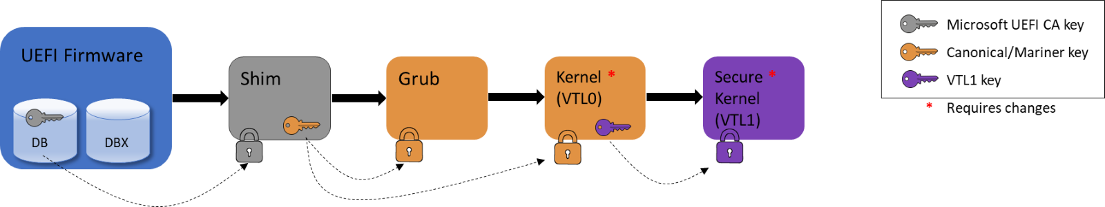
Architecture:
Boot
We trust secure boot !
VTL0 guest kernel boots up VTL1 secure kernel
Establish kernel hardening and other policies with secure kernel prior to init process.

Slide 22
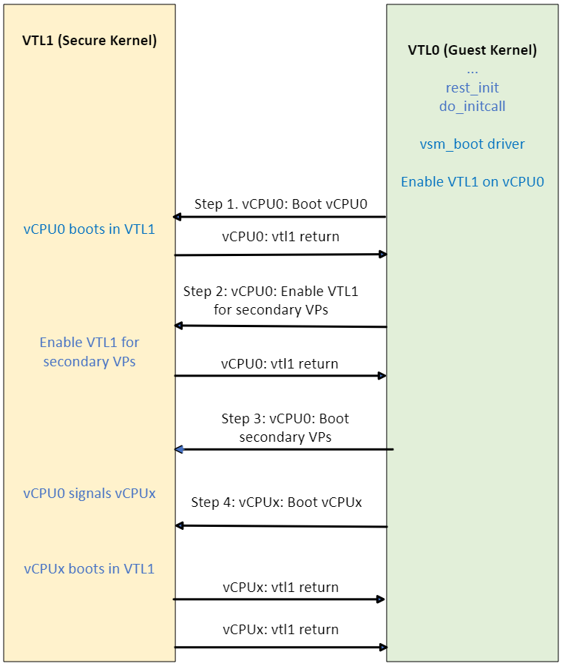
Architecture:
Boot Sequence

Slide 23
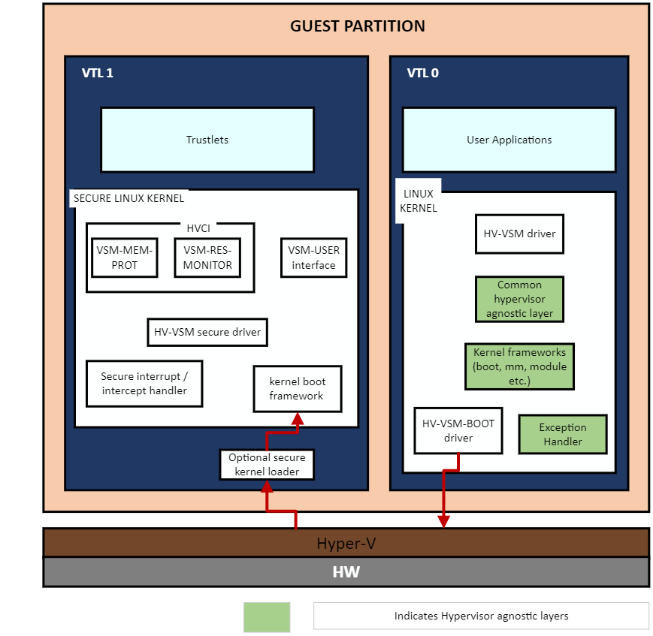
Architecture :
The Big Picture
( Boot )

Slide 24
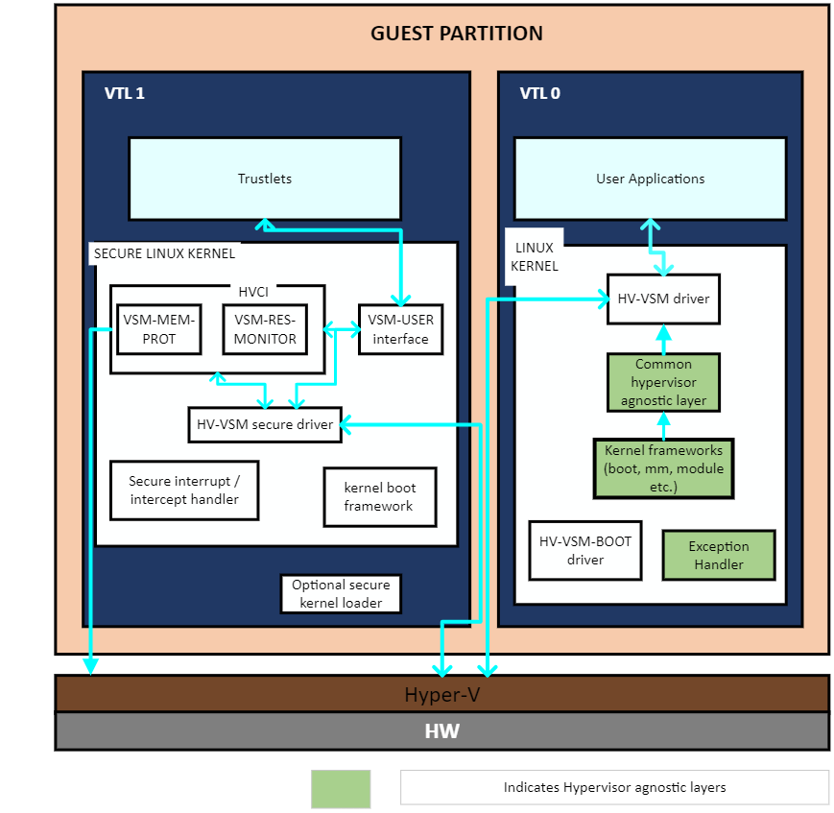
Architecture:
The Big Picture
( Late Boot )

Slide 25
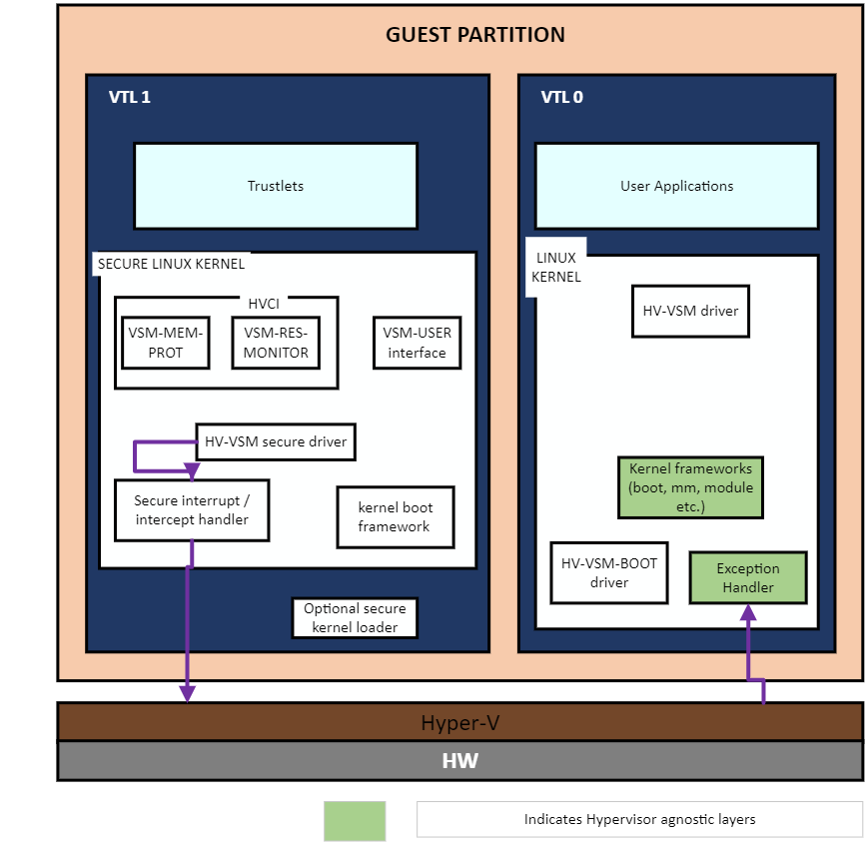
Architecture
( Access / Policy Violation)

Slide 26
Code
https://github.com/heki-linux/lvbs-linux/tree/secure-kernel-lvbs
https://github.com/heki-linux/lvbs-linux/tree/ubuntu-lvbs

Slide 27
KVM Implementation (Heki)
Mickaël Salaün

Slide 28
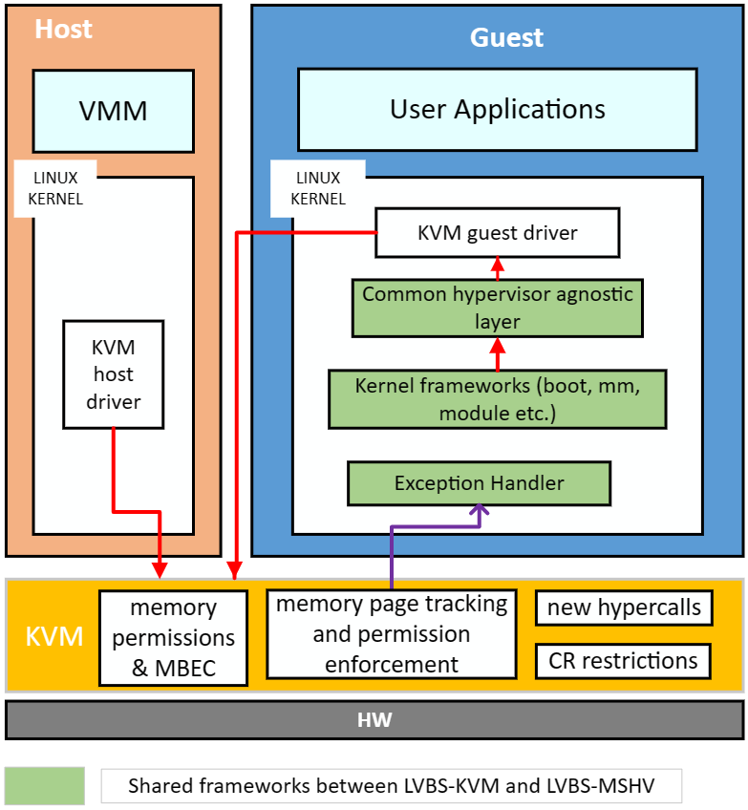
Architecture :
The Big Picture

Slide 29
RFC v2 patches
Sent RFC v2:
Guest kernel implementation of the common API
Two new KVM hypercalls: CR-pinning and memory permission
KVM interface with the VMM: dedicated VM exits and related capabilities

Slide 30
CR-pinning hypercall
Enforce a bitmask on control registers to guard against locked features (e.g. SMEP)
kvm_hypercall3(KVM_HC_LOCK_CR_UPDATE,
0, // control register
X86_CR0_WP, // flag to pin
flags); // options
Can create a VM exit on configuration or policy violation for the VMM to be able to do something.
Generate a GP fault on policy violation.

Slide 31
Memory protection hypercall
Configure (a subset of) EPT permissions.
kvm_hypercall1(KVM_HC_PROTECT_MEMORY,
pa); // address of a pagelist
The pagelist atomically maps a set of memory ranges with read, write and execute permissions.
Generate a synthetic page fault on policy violation.
Notes:
Configure VMCS

Slide 32
Executable permission(s)
Issue: efficiently enforce restriction on kernel executable pages without impacting access to user space pages
Solution: leverage Intel’s Mode Based Execution Control (MBEC)
Split the execution permission into:
Kernel mode execution
User mode execution

Slide 33
Kernel memory permissions without MBEC
0xFFFF…
executable
___end_rodata
read-only
vdso_end
read-execute
vdso_start
read-only
___start_rodata
executable
_etext
read-execute
_text
executable
0x0000…

Slide 34
Kernel memory permissions with MBEC
0xFFFF…
non-executable
___end_rodata
read-only
vdso_end
vdso_start
___start_rodata
non-executable
_etext
read-execute
_text
non-executable
0x0000…

Slide 35
Code
https://github.com/heki-linux/linux
branch heki-v2

Slide 36
Wrap up
KVM and Hyper-V supports:
defense-in-depth mechanism leveraging hardware virtualization
common API layer across hypervisors
Any feedback?
https://github.com/heki-linux

Slide 37
Q&A

Slide 38

Thank you

Slide 39
Demo: control-register pinning
(SMEP)

Slide 40
